Slide 1
Ch. 3 S. 1 Quiz
1. Explain how Social Darwinism motivated how government policies encouraged business.
2. Do you think Carnegie’s dedication to philanthropy offset his reputation as a robber baron? Why or why not?
3. Explain how Rockefeller created his monopoly?
4. Would you support Capitalism or Socialism more and why?
5. What was an effect of the Homestead and Pullman Strikes?
6. How much did Carnegie’s steelworkers make an hour?

Slide 2
Ch. 3 S. 1 Quiz Answers
Explain how Social Darwinism motivated how government policies encouraged business.
A. “Survival of the fittest”, “natural selection”, laissez faire and idea for hands off gov’t
2. Do you think Carnegie’s dedication to philanthropy offset his reputation as a robber baron? Why or why not?
A. Yes – Donated money to help support to public, “Gospel of Wealth” No – Terrible working conditions in his factories, paid low wages, long hours, etc.
3. Explain how did Rockefeller create his monopoly?
A. Horizontal Consolidation, he purchased all competing small companies and merged them into his oil company, creating a monopoly.
4. Would you support Capitalism or Socialism more and why?
A. Capitalism – lassiez faire, “survival of the fittest”
Socialism – Gov’t owns means of production, equal share
5. What was an effect of the Homestead and Pullman Strikes?
A. Steelworkers union lost support and lost their union, Pullman workers were fired and blacklisted from railroad jobs.
6. How much did Carnegie’s steelworkers make an hour?
A. 15 cents

Slide 3
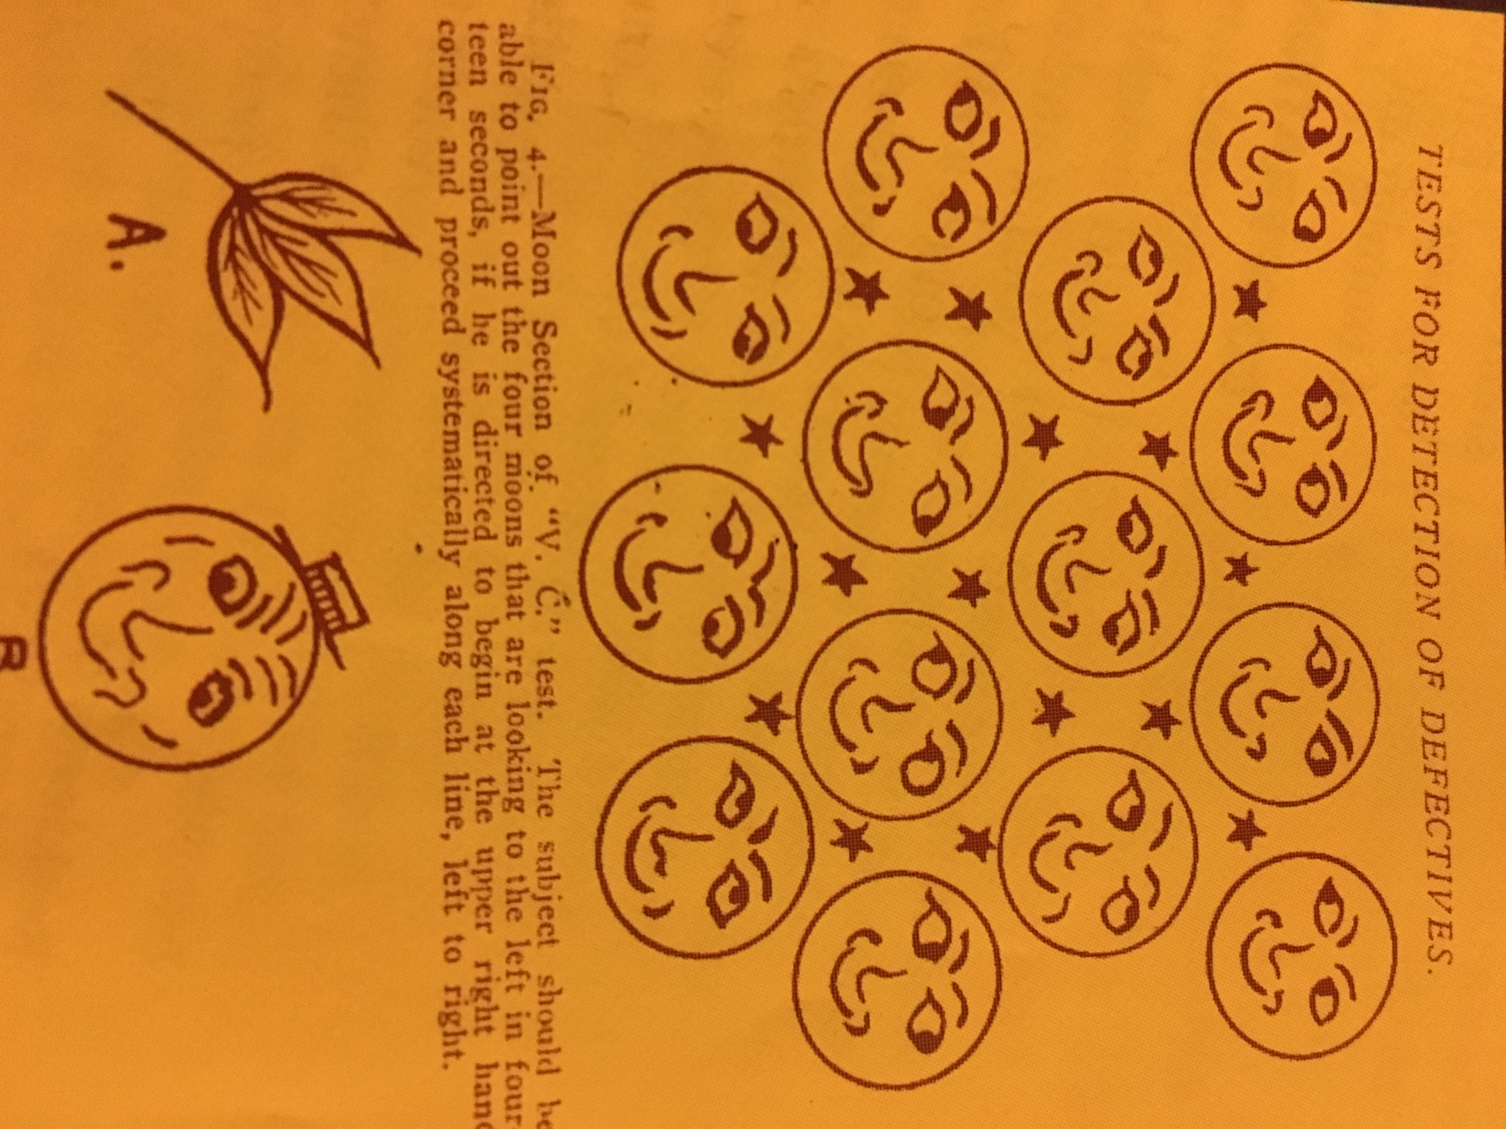

Slide 4
Gallery Walk
In your groups, read your section and create a poster that highlights main points.
When completed, choose two people to be the first “teachers”, these students will “teach”, while the other two group members will go from poster to poster learning about each section. When the first round is completed, the first two “teachers” will then trade places and the other two group members now become the “teachers” while the other two group members learn form the other posters.
1 -> 2 -> 3 -> 4 -> 5 -> 6 -> 7 -> 8 -> 9 -> 1

Slide 5
Gallery Walk
Group One: Why It Matters & New Immigrants Come to America, pg 73.
Group Two: New Immigrants Arrive From Many Lands & Push-and-Pull Factors, pg 74
Group Three: The Immigrant Experience & Opportunities and Challenges, pg 74 & 75.
Group Four: Arriving in a New Land & “Ellis Island”, pg 74 & 75.
Group Five: Cities Experience Growth and Change & Immigrants and Farmers Move to Cities, pg 76.
Group Six: Technology Improves Urban Life, pg 76.
Group Seven: Urban Life Creates Problems, pg 76 & 77.
Group Eight: Social and Cultural Trends & A New Middle Class Emerges, pg 78.
Group Nine: Culture and Entertainment Abound & Religion Attracts Urban Masses, pg 78 & 79.

